Slide 1



Silverlight
Session 2
Copyright © 2009. Cybage Software Pvt. Ltd. All Rights Reserved. Cybage Confidential.

Slide 2
www.cybage.com
Agenda
XAML
Layout System
Content Model
Templates
Styles
Resources
...
Copyright © 2009. Cybage Software Pvt. Ltd. All Rights Reserved. Cybage Confidential.

Slide 3
www.cybage.com
Introduction to XAML
XAML is eXtensible Application Markup Language
IntelliSense Support
Currently used in WPF / Silverlight / Window Workflow Foundation
XAML elements map directly to CLR object instances, while XAML attributes map to CLR properties and events on those objects.
XAML files can be created and edited with visual design tools such as Microsoft Expression Blend, Microsoft Visual Studio, and Windows Workflow Foundation visual designer
Supports code behind programming model. Separates design from code allowing graphics designers and coders to work together on the same project
...
Copyright © 2009. Cybage Software Pvt. Ltd. All Rights Reserved. Cybage Confidential.

Slide 4


www.cybage.com
Introduction to XAML
...
XAML
C#
VB.NET
<Button Width="100"> OK
<Button.Background>
LightBlue
</Button.Background>
</Button>
Button b1 = new Button();
b1.Content = "OK";
b1.Background = new SolidColorBrush(Colors.LightBlue);
b1.Width = 100;
Dim b1 As New Button
b1.Content = "OK"
b1.Background = New _ SolidColorBrush(Colors.LightBlue)
b1.Width = 100
Copyright © 2009. Cybage Software Pvt. Ltd. All Rights Reserved. Cybage Confidential.

Slide 5
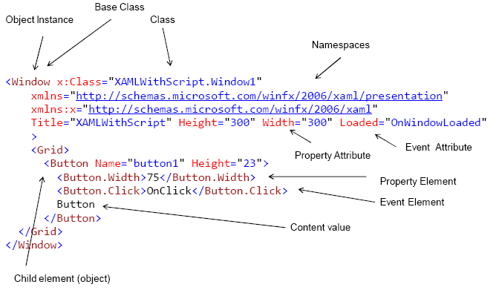
www.cybage.com
Introduction to XAML
...
Copyright © 2009. Cybage Software Pvt. Ltd. All Rights Reserved. Cybage Confidential.

Slide 6
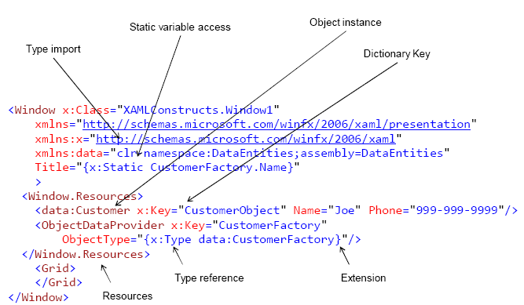
www.cybage.com
Introduction to XAML
...
Copyright © 2009. Cybage Software Pvt. Ltd. All Rights Reserved. Cybage Confidential.

Slide 7
www.cybage.com
Layout System
Fixed Layout
Dynamic Layout
Full Screen Mode
Silverlight and HTML layout
...
Copyright © 2009. Cybage Software Pvt. Ltd. All Rights Reserved. Cybage Confidential.

Slide 8
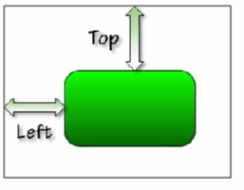

www.cybage.com
Layout System
Fixed Layout
Canvas : Defines an area within which you can explicitly position child elements by coordinates relative to the Canvas area.
Canvas.Left
Canvas.Top
Attachable Properties
...
Copyright © 2009. Cybage Software Pvt. Ltd. All Rights Reserved. Cybage Confidential.

Slide 9
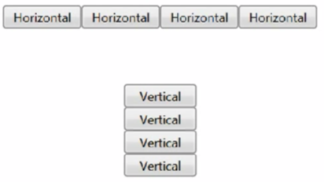
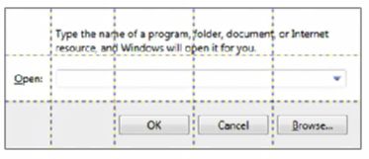
www.cybage.com
Layout System
Dynamic Layout
Adaptable To : Quantity Of Information, Size of items & Space available
Stack Panel : Arranges child elements into a single line that can be oriented horizontally or vertically.
Grid : Defines a flexible grid area consisting of columns and rows.
Stack Panel Grid
...
Copyright © 2009. Cybage Software Pvt. Ltd. All Rights Reserved. Cybage Confidential.

Slide 10

www.cybage.com
Layout System
Full Screen Mode
Plug-in can run in full screen mode
Security Constraints
Can only set in input related event handler
Always displays a message
...
Copyright © 2009. Cybage Software Pvt. Ltd. All Rights Reserved. Cybage Confidential.

Slide 11
www.cybage.com
Layout System
Silverlight and HTML layout
Silverlight root element constrained by HTML/CSS
Plug-in cannot size to content
Adjusting HTML layout based on Silverlight layout
Layout Updated event
Windowless
...
Copyright © 2009. Cybage Software Pvt. Ltd. All Rights Reserved. Cybage Confidential.

Slide 12
www.cybage.com
Content Model
Conventional Windows Programming world had control and associated fixed set content that it could display. For e.g. a button control could have “Text” or Label could have “Text” and combo box – with few set selection items with “Text”.
Combining content like “Text” and “Image” required additional work of creating custom controls or some efforts in getting the controls to work.
WPF/Silverlight defines this content as Object and allow to add any content to the control with fewer assumptions.
Copyright © 2009. Cybage Software Pvt. Ltd. All Rights Reserved. Cybage Confidential.

Slide 13
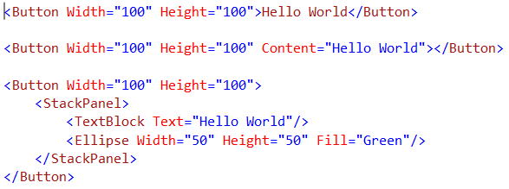
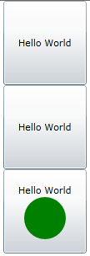
.
www.cybage.com
Content Model
Control Content Model
Copyright © 2009. Cybage Software Pvt. Ltd. All Rights Reserved. Cybage Confidential.

Slide 14


.
www.cybage.com
Content Model
Decorator Content Model
Copyright © 2009. Cybage Software Pvt. Ltd. All Rights Reserved. Cybage Confidential.

Slide 15

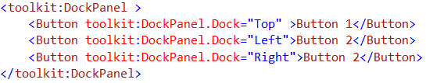
.
www.cybage.com
Content Model
Panel Content Model
This content model overview describes the supported content for a Panel. Stack Panel and Dock Panel are examples of Panel objects.
A Panel has the Children as its content properties
The Children property can contain multiple objects, even other Panel objects.
Copyright © 2009. Cybage Software Pvt. Ltd. All Rights Reserved. Cybage Confidential.

Slide 16
www.cybage.com
Templates
Allow designers of an application, document, or user interface (UI) to create visually compelling effects and to standardize on a consistent appearance for their product.
Replace visual of Controls
Features like styles, templates, triggers, and storyboards are provided.
WPF styling model(templates) is the separation of presentation and logic. This means that designers can work on the appearance of an application using only XAML at the same time that developers are working on the programming logic using C# or Visual Basic.
...
Copyright © 2009. Cybage Software Pvt. Ltd. All Rights Reserved. Cybage Confidential.

Slide 17
www.cybage.com
Templates
DataTemplate is used to create a visualization of a non-visual object, such as a business object.
ControlTemplate supplies a visual representation of a UI control, such as a Button or ListView.
ItemsControl, and all of its subclasses (such as ListBox), create the layout panel that hosts their child elements via an ItemsPanelTemplate.
HierarchicalDataTemplate, which is a data template that has knowledge of how to display a data object’s child objects, such as in a master-detail situation.
...
Copyright © 2009. Cybage Software Pvt. Ltd. All Rights Reserved. Cybage Confidential.

Slide 18
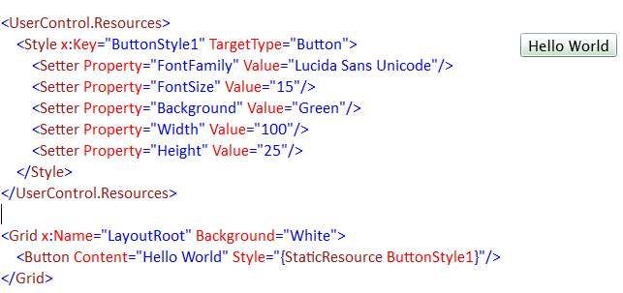
www.cybage.com
Styles
Style is a collection of property values.
Apply group of properties across multiple element.
Style can be declared in
...
Copyright © 2009. Cybage Software Pvt. Ltd. All Rights Reserved. Cybage Confidential.

Slide 19
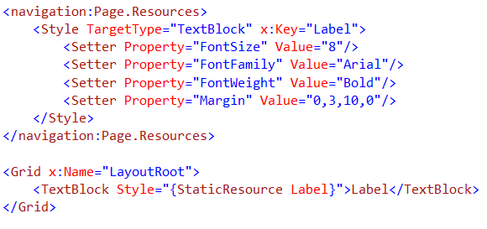
www.cybage.com
Resources
A resource in Silverlight is a quick and easy way to re-use commonly defined objects and values over your XAML or in general Silverlight code
Resources can be defined in
App.xaml, Any Framework Element and Resource Dictionary
...
Copyright © 2009. Cybage Software Pvt. Ltd. All Rights Reserved. Cybage Confidential.

Slide 20
www.cybage.com
Summary
XAML
Layout System
Content Model
Templates
Resources
Copyright © 2009. Cybage Software Pvt. Ltd. All Rights Reserved. Cybage Confidential.

Slide 21

www.cybage.com
Thank You!
Copyright © 2009. Cybage Software Pvt. Ltd. All Rights Reserved. Cybage Confidential.

